Slide 1
Strategic Planning- A Primer for HR Pros
Presenter:
Charlie Phelps

Slide 2
Strategy
Strategy is the art of working out how to win in business and life.
It involves understanding your environment, crafting a unique and valuable competitive position, and using your resources in such a way that you make best use of the opportunities open to you.
James Manktelow
Mind Tools CEO

Slide 3
Business-Level Strategies
Generic Strategies - How the firm intends to position itself to create value for its customers in ways that are different from those of competitors
Competitive Tactics - the competitive Actions firms take to grow and increase the strength of or protect their competitive positions.

Slide 4
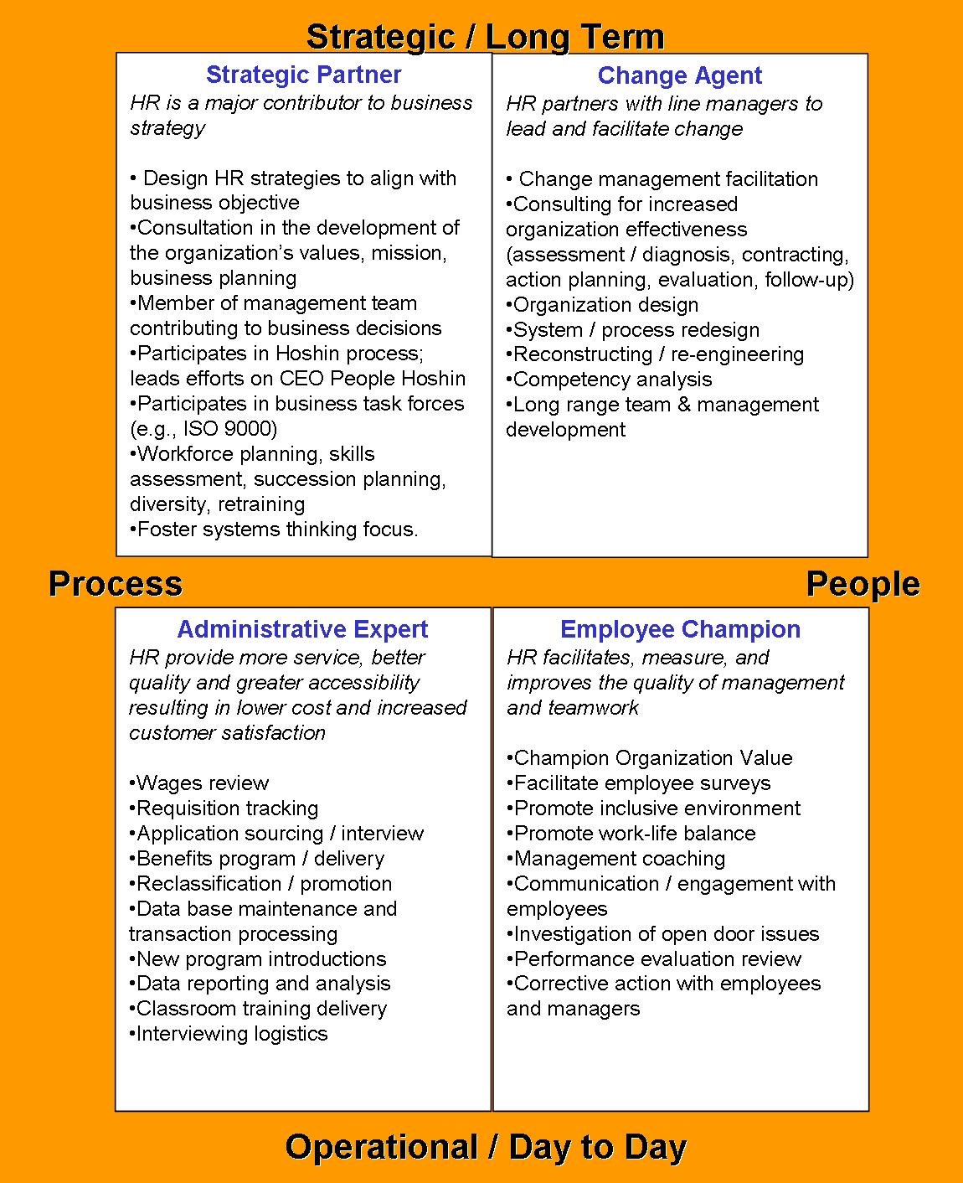
Strategic, tactical, or both
Process
People
See Handout

Slide 5
Strategic Thinking
Strategic thinking is the term used to describe the creative aspects of strategic management
Focus on strategic intent
Long-term orientation
Consideration of past and present
Systems perspective
Ability to seize unanticipated opportunities
Scientific approach

Slide 6
Strategic Management
Is the process through which organizations…
Analyze and learn from their internal and external environments,
Establish strategic direction,
Create strategies that are intended to help achieve established goals, and
Execute those strategies….
All in an effort to satisfy key
organizational stakeholders.

Slide 7
Stages in strategic management
Mission Determination
Ensure HR is aligned with company vision & mission
Strategic/Environmental Analysis
Human Resource environment
Human Resource legal environment
External environment
Strategic Direction
Setting objectives
Strategy Formulation
Human Resource planning
Strategy Implementation & Control
Workforce utilization and employment practices
Reward and development system
Performance impact of human resource practices
Human Resource evaluation

Slide 8
Strategic Management Process
External and Internal Analysis
Strategy Formulation
(corporate and business level)
Strategic
Direction
Strategy Implementation
and Control
Strategic Restructuring

Slide 9
Mission and Vision
Mission What the organization is
Vision What the organization wants to become
Frequently a vision is incorporated into the mission statement, as illustrated in this example:
“Our mission is to be the world’s premier consumer products company focused on convenient foods and beverages. We seek to produce financial rewards to investors as we provide opportunities for growth and enrichment to our employees, our business partners and the communities in which we operate. And in everything we do, we strive for honesty, fairness and integrity .” (Pepsico)
Note also that this mission statement incorporates important values
(Honesty , Fairness and Integrity)

Slide 10
Internal Environmental Analysis
Internal stakeholders include managers, employees and the owners and their representatives (e.g., board of directors).
Internal analysis includes an evaluation of internal stakeholders and the organization’s resources and capabilities
Purpose of internal analysis is to determine
strengths and opportunities for competitive advantage, and
weaknesses and organizational vulnerabilities that should be corrected.

Slide 11
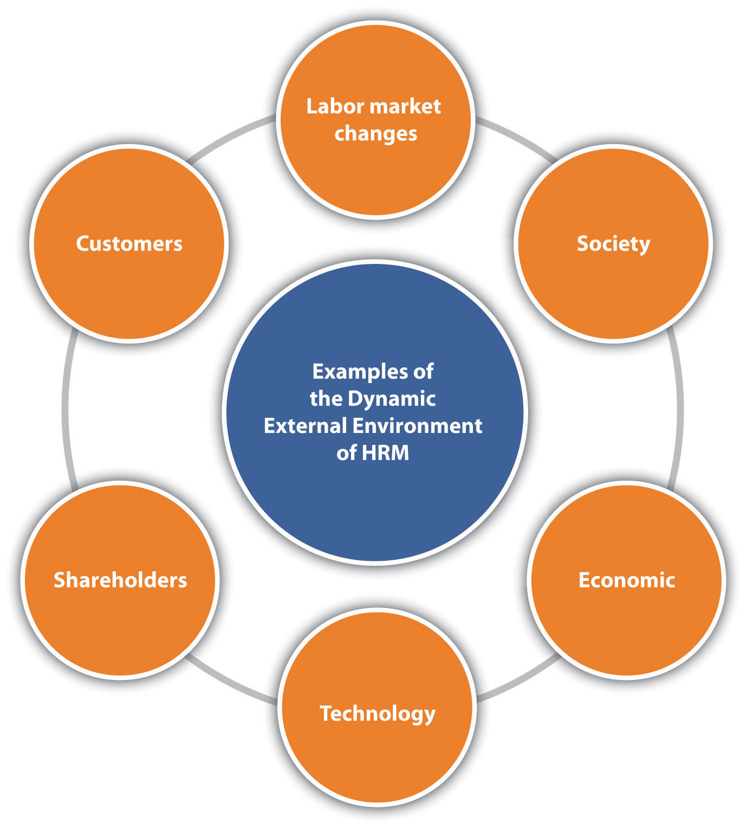
External environmental analysis
The HR professional must understand the dynamic nature of the HRM environment, such as changes in labor markets, company culture and values, customers, shareholders, and the economy.

Slide 12
Broad Environment
The broad environment consists of domestic and global forces such as:
Socio-cultural trends (e.g. demographics)
Technological trends (e.g. internet)
Political trends (e.g. open markets)
Economic trends (e.g. growing economy)
The broad environment forms the context within which the firm and its task environment exist.

Slide 13
THE BROAD ENVIRONMENT
Sociocultural
forces
Technological
forces
THE TASK ENVIRONMENT
Competitors
THE ORGANIZATION
Financial
Intermediaries
Owners/Board of Directors
Managers Employees
Suppliers
Customers
Unions
Local communities
Government
Activists
Economic
forces
Political/Legal
forces

Slide 14
Task Environment
The Task Environment consists of external stakeholders -- groups or individuals outside the organization that are significantly influenced by or have a major impact on the organization -- such as:
Customers
Suppliers
Competitors
Communities
Financial intermediaries

Slide 15
SWOT Analysis Tool #1
Strengths are firm resources and capabilities that can lead to a competitive advantage.
Weaknesses are resources and capabilities that the firm does not possess but that are necessary, resulting in a competitive disadvantage.
Opportunities are conditions in the broad and task environments that allow a firm to take advantage of organizational strengths, overcome organizational weaknesses, and/or neutralize environmental threats.
Threats are conditions in the broad and task environments that may stand in the way of organizational competitiveness or the achievement of stakeholder satisfaction.

Slide 16
Strategic Direction
Strategic direction involves
Setting long-term goals and objectives
Defines the purposes for which an organization exists and operates
business ethics pertain to the moral obligations of businesses to individuals, groups (such as stakeholders) and society as a whole
values define what matters when making decisions and what is rewarded and reinforced
Strategic direction may be contained, in part, in a firm's mission and vision statements

Slide 17
Porter’s Five Forces Tool #2

Slide 18
The Five Forces

Slide 19
The Industry Life Cycle
A
Growth
B
Unit Sales Volume
Maturity
C
Introduction
Commodity or Decline
Time
Notes:
The product life cycle describes the stages most products - and industries - evolve through from creation to maturation. Study of product life cycle concepts can help an organization understand the dynamic nature of strategy. As a product moves through the stages of the life cycle, different strategies and organizational resources are needed to compete effectively.
In the introduction stage, firms attempt to produce a product that is of sufficiently high quality that they will be able to establish a good reputation in the market. The emphasis is often on research and development. Early producers sometimes enjoy a "first-mover advantage.",
During the growth stage, as demand greatly expands and the number of competitors increases, existing competitors may attempt to erect entry barriers by building plants that are large enough to enjoy economies of scale, locking in contracts for supplies or distribution of products, or differentiating products through advertising and new features or service. At this stage, products are much more standardized and competition tends to focus on product quality and availability.
During the maturity stage, as demand continues to level off, efficient, high volume production tends to dominate manufacturing strategy. A dominant design for the product has probably emerged, and therefore consumers typically focus on price and dependability. Product differentiation becomes increasingly difficult. Marketing, distribution efficiency and low cost operations gain increasing importance during this stage.
Finally, during the commodity or decline stage, tight cost controls leading to efficiency are essential to success.
Discussion Prompt: How important is it for a firm to align with the dominant characteristics of each stage of the product life cycle? (Use this prompt to revisit the discussion of determinism versus enactment from earlier chapters). What if a company chooses NOT to align with the dominant design that emerges in the latter stages of the life cycle – but instead chooses to continue to pursue a form of differentiation in a niche segment of the market?

Slide 20
Strategy Formulation
Strategy is an organizational plan of action intended to accomplish goals.
Corporate strategy formulation refers to domain definition, or the choice of business areas. Usually decided by the CEO and the board of directors.
Business strategy formulation involves domain direction and navigation, or how to compete in a given area. Usually decided by division heads and business unit managers.
Functional strategy formulation contains the details of how the functional areas such as marketing, operations, finance, and research should work together to achieve the business-level strategy. Decisions made by functional level managers.

Slide 21
Well-Developed Functional Strategies
Business-level strategies are implemented at the functional level
01
Decisions made in each functional area are consistent with each other
02
Decisions made within one function are consistent with those made in other functions
03
Decisions within functions are consistent with the strategies of the business
04

Slide 22
HR Strategic Planning
Think of the HRM strategic plan as the major objectives the organization wants to achieve, and the HR plan as the specific activities carried out to achieve the strategic plan. In other words, the strategic plan may include long-term goals, while the HR plan may include short-term objectives that are tied to the overall strategic plan.
The HR professional must understand the dynamic nature of the HRM environment, such as changes in labor markets, company culture and values, customers, shareholders, and the economy.

Slide 23
Human Resources Strategy
Defines approach to recruitment, selection, training, performance evaluation, performance rewards, and other key HR practices
Effective human resources strategies can be excellent sources of competitive advantage.
HR managers serve a coordinating role between the organization’s management and employees, and between the organization and external stakeholder groups
Important to establish effective human resources policies and communicate them to all of the managers in the organization who are involved in carrying them out.

Slide 24
HR Planning

Slide 25
Strategy Implementation and Control
Strategy implementation involves creating the functional strategies, systems, structures, and processes needed by the organization in achieving strategic ends.
Strategic control refers to the processes that lead to adjustments in strategic direction, strategies, or the implementation plan when necessary.
Strategic restructuring involves a renewed emphasis on what an organization does well, combined with a variety of tactics to revitalize the organization and strengthen its competitive position.

Slide 26
Organizational Structure
The number and types of departments or groups, formal reporting relationships and lines of communication
Structure is a means, not an end
There is no one best structure
Structure can constrain future strategic choices
Administrative inefficiencies, poor service, communication problems or employee frustrations may indicated a strategy-structure mismatch

Slide 27
Organizational Culture
An organization’s culture, the system of shared values that guides employee beliefs and behavior, influences the success of strategy implementation.
Often reflects the values and leadership styles of top executives
Human resource management practices can influence culture – recruitment, training, performance evaluation
Organizational energy – intensity and extent to which it is directed towards achievement of firm goals

Slide 28
Factors that Encourage Innovation and Entrepreneurship
Strategic direction that incorporates innovation and entrepreneurship
Culture that encourages creative thinking and risk taking
Top management support of entrepreneurship
Open communications supported by an integrated information systems
Valuing the ideas of every employee
Large rewards for internal entrepreneurs
Teamwork and collaboration
A flat management hierarchy with decentralized decision making
Organizational champions to gather resources
Focus on learning
Slack resources available to invest in entrepreneurship

Slide 29
Factors that Discourage Innovation and Entrepreneurship
Strategic direction that emphasizes financial returns or operating efficiency
Culture that rewards conformance and discourages novel ideas
Top management that encourages maintaining the status quo
Closed door offices and disorganized and ineffective information system.
Attention given mostly to researchers or managers
Harsh penalties for failures

Slide 30
Factors that Discourage Innovation and Entrepreneurship (Cont,)
Authoritarian leadership
A tall hierarchy - a lot of bureaucratic red tape and many approval levels
Approval process that makes it difficult to gather new resources
Exclusive emphasis on measurable outcomes
Tight finances (high debt, few liquid assets)

Slide 31
Strategic Control System
A system to support
managers in….
Assessing whether the organization’s strategy is accomplishing goals as intended
Identifying areas needing attention

Slide 32
Types of Control
Feedback - Provides managers with performance information so that they can make adjustments if necessary
Concurrent - Provides real-time information used to control organizational processes
Feedforward – Monitoring systems that help managers anticipate changes in their external and internal environments

Slide 33
Feedback Controls
Functions of feedback controls in organizations:
Creating specific objectives or targets ensures that managers understand the plans and strategies that guide firm decisions
Motivate managers to pursue organizational interests
Help managers decide when and how to intervene to make corrections

Slide 34
Elements in a Feedback Control System
Establish Broad Goals Based on Mission, Vision,
and Purpose
Identify Key Result Areas for Each of the Broad Goals
Establish Targets for Each Result Area and a Time Frame for Accomplishment
Follow Up
With
Each Manager
Develop an Action Plan for Accomplishing
Each Target
Make a Specific Manager
Responsible
for Each Target
Notes:
Effective feedback controls are one way to help ensure that the strategies are indeed moving the organization in an appropriate direction.
They create specific objectives or targets, which ensures that managers at various levels and areas in the organization understand the plans and strategies that guide organizational decisions.
Feedback control systems motivate managers to pursue organizational interests as opposed to purely personal interests, because they know they will be held accountable for the results of their actions.
Feedback control systems help managers decide when and how to intervene in organizational processes by identifying areas that require further attention. Without good control systems, managers can fall into the trap of spending too much time dealing with issues and problems that are not particularly important to the future of the organization.

Slide 35
A BSC Is… tool #3
A BALANCED SCORECARD IS
a performance metric used in strategic management to identify and improve various internal functions of a business and their resulting external outcomes. It is used to measure and provide feedback to organizations.
THE BALANCED SCORECARD (BSC) IS
a strategic planning and management system that organizations use to: Communicate what they are trying to accomplish. Align the day-to-day work that everyone is doing with strategy. Prioritize projects, products, and services.
THE SYSTEM CONNECTS THE DOTS
between big picture strategy elements such as mission (our purpose), vision (what we aspire for), core values (what we believe in), strategic focus areas (themes, results and/or goals) and the more operational elements such as objectives (continuous improvement activities), measures (or key performance indicators, or KPIs, which track strategic performance), targets (our desired level of performance), and initiatives (projects that help you reach your targets).

Slide 36
The 4 Perspectives of a BSC
The BSC suggests that we view the organization from four perspectives, and to develop objectives, measures (KPIs), targets, and initiatives (actions) relative to each of these points of view:
Financial: often renamed Stewardship or other more appropriate name in the public sector, this perspective views organizational financial performance and the use of financial resources
Customer/Stakeholder: this perspective views organizational performance from the point of view the customer or other key stakeholders that the organization is designed to serve
Internal Process: views organizational performance through the lenses of the quality and efficiency related to our product or services or other key business processes
Organizational Capacity (originally called Learning and Growth): views organizational performance through the lenses of human capital, infrastructure, technology, culture and other capacities that are key to breakthrough performance

Slide 37
The Future
Trends:
Increasing global complexity and interconnectedness, fueled by technological advancements
Specialized, mobile and diverse labor pools, including those found outside home countries
Education levels, income levels and access to capital will continue to grow worldwide
New powerful competitors in global marketplace
Increased concern about governance, sustainability and social responsibility; increased regulation

Slide 38
18 roles….. for HR in 2018
The Accelerator
Speed is of utmost importance. HR can help to accelerate processes and decision making. The pace in most organizations is too slow. The year is still the most important planning building block. HR can do a lot to help to increase the speed. Hire speedy persons. Get rid of, or redesign, slow and bureaucratic processes. Stop with one-size-fits-all concepts. Adopt ‘Just-in time’ and get rid of ‘Just-in-case’.
The Challenger
We need people who dare to challenge at the top. Group think is observed too often. The plans are always ambitious and will result in more growth. Nobody wants to be the party pooper. Nobody wants to be perceived as a blocker. This is where HR can show its independency, and challenge where others choose to be followers.

Slide 39
18 Roles 3 & 4
The Connector
In today’s organization it is all about connections. HR must focus on building and strengthening the connections. Between countries. Between functional areas. Between old and young. Between Baby Boomers and Gen Y and Gen Z. Between old and new. Between early adaptors and followers. Between change lovers and stabilizers. Between inner circle and outer circle. Between leaders and followers. Between HQ and the people at the front.
The Data-cruncher
Traditionally data analysis is not one of the core competencies of HR. It should be, and modern technology will help a lot. HR can have its sensors out wide in the organization. What is happening with the engagement levels of people in critical projects? What capabilities are slowly eroding? Moving people analytics from descriptive to predictive.

Slide 40
18 Roles 5 & 6
The Designer
Can organizations be beautiful? Can organizations be a place where it is fun to be? HR can play a more active role in workplace design. Functionality and efficiency: yes, but let’s as HR add the people element. Let’s also make sure what we design can fulfil the needs of different groups. Another type of designer is the employee journey designer (see role 7).
The Employee Champion
One of the most undervalued roles in the original Ulrich model is finally getting some traction. For years HR has focused on becoming part of senior management (or al least getting as close as possible to senior management). Nobody wanted to be an administrative expert, and focusing on the employees was also very old fashioned. This is changing, and employee intimacy is becoming more important.

Slide 41
18 roles 7 & 8
The Employee Journey Designer
The employee journey and the employee experience are becoming mainstream in 2018. Designing the journey, from start to finish, is becoming an important role of HR. Read: Where to start when you want to improve the employee experience? (https://hrtrendinstitute.com/2017/04/21/start-employee-experience/)
The Experimenter
We can learn a lot of experiments. HR can drive experiments. Do not strive to design the global all-encompassing process, practice or system that will be future-proof. Time goes by and nothing happens. Start experiments with those parts of the organization that love something new. Implement, learn, adapt and start a new experiment.

Slide 42
18 roles 9 & 10
The Guardian of the Values
Organizations and people become more and more values driven. Strong values need to be nourished and defended. HR leaders should be role models that through their behaviors show that they are living the values.
The Magician
Top HR professionals can be magicians. For example, by producing surprising insights with the help of people analytics. Management and employees like surprising insights, and HR can provide them. Sourcing surprising candidates is another area where HR can add a lot of value.

Slide 43
18 roles 11 & 12
The Mediator
The HR pro keeps her head cool. She is focused and immune to distractions. She finds time to mediate every day. Headspace is her favorite app.
The Performance Consultant
Some people are better in giving feedback than others. It is probably better to make use of the capabilities of these people, then to train all people to give better feedback. Performance consulting is an excellent role for HR: helping good people to become better.

Slide 44
18 roles 13 & 14
The Receptionist
Administrative Expert was the least desirable role in the Ulrich model (see also role 6). An important element in the HR service center is hospitality. If organizations investigate how employees experience their journey, they often mention how difficult it is to find relevant HR information. The intranet contains may pages, but to find the right information is cumbersome. If you try to contact the HR service center, they are difficult to reach. Hospitality should be high on the capability list of HR employees in the service center. Although chatbots will play an important role, for more complex issues we will need human interaction. Read: HR Operations in the lift (https://hrtrendinstitute.com/2017/02/20/hr-operations-in-the-lift/).
The Slacker
Some time ago there was a nice blog with the title “What happened to down time; the extinction of deep thinking & sacred space (http://99u.com/articles/6947/What-Happened-to-Downtime-The-Extinction-of-Deep-Thinking-Sacred-Space)”.
Downtime is needed. HR can be exemplary here as well. Do not plan meetings back-to-back. Do not judge people who allow themselves some slack.

Slide 45
18 roles 15 & 16
The Smooth Operator
This role is related to role 13, the receptionist. The smooth operator knows her IT-stuff. HR processes and workflows are running smoothly in the background, and offer all the users (candidates, employees, managers) a world class experience. The smooth operator is invisible, but very important as the engine of HR.
The Storyteller
2018 will also be a year of storytelling. Through stories we can learn about the ambitions of the company. Through stories we can learn what living the values really means. Through stories we can connect the organization to the surrounding world. HR could be the master of storytelling.

Slide 46
18 roles 17
The Techie
HR tech offers numerous opportunities. HR should be tech savvy, and be able to find solutions that can help to increase the impact of HR. Not an easy role. There are many solutions on the market, and the HR tech landscape is changing every day.
Read: HR Tech Trends Often Ignored By HR https://hrtrendinstitute.com/2017/12/19/hr-tech-trends-often-ignored-by-hr/
Have a look at the HR Tech Community

Slide 47
18 roles 18
The Voice
As one of the major HR trends for 2018, we mentioned “Power to the People.”
Many organizations are still used to work in a top-down way. In those organizations, also HR finds it difficult to approach issues in a different way.
Performance management is a good example. Changing the performance management process is often tackled as an organization wide issue, and HR needs to find the new uniform solution.
In line with the trend called “The Consumerization of HR” https://hrtrendinstitute.com/2017/01/09/consumerisation-hr/ employees are expected to take more initiative, being tired of waiting for the organization and HR, and wanting to be more independent of organizational initiatives.
If HR is clever, it senses the needs and ideas in the undercurrent of the organization, and acts as the voice that expresses these ideas.

Slide 48
Comments evaluations
THANK YOU!

