Slide 1
The Value of Diversity in the Workplace
Why Diversity?

Slide 2
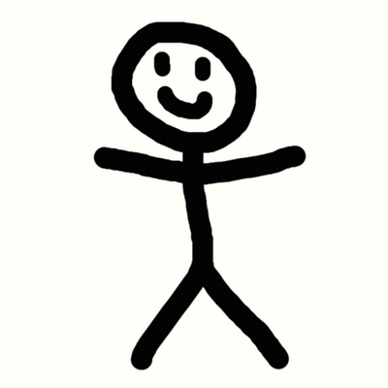
The human body is the same for all humans:
Skeletal System - bones
Muscular System - body mass
Circulatory System- heart and veins,
respiratory system – mouth and nose, trachea, lungs,
Digestive System - food and nutrients
Nervous System - brain and nerves

Slide 3
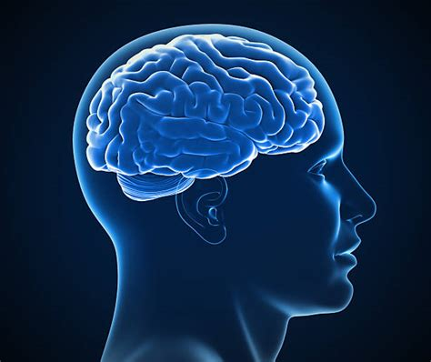
If our bodies are the same, why do we need a presentation on Diversity?
The nervous system and how Information is processed
1. Sensory Memory - Sight, Sound, Smell, Taste, and Touch
2. Working (short term) Memory
3. Long Term Memory

Slide 4
Bias
Dine’
Hozho’
Ya’at’eeh

Slide 5
Navajo Culture
Subsistence - Food, shelter
Navajo concept: Iina’- air, sun light/fire, water, earth/pollen
Beliefs, rituals, values, societal arrangements, manners, ideas
Language – Diyin Nohookaa Dine’ Bizaad
Beliefs about economic and social relations
Political organization and legitimacy
And the thousands of "Do’s and Don'ts" society deems important that we know to become a functioning member of that group

Slide 6
Fundamental Laws
Diyin Bitsaadee’ Beehaz’a’ani – Ceremonial Laws & Rituals
Diyin Dine’e’ Bitsadee’ beehaz’a’ani – Laws that emanate from the Holy Beings
Nahasdzaan doo Yadilhil Bitsaadee Beehaz’a’ni – Natural Laws, Laws of the Universe
Diyin Nohookaa Dine’ bi Beehazaani – Man made laws, common and statutory laws

Slide 7
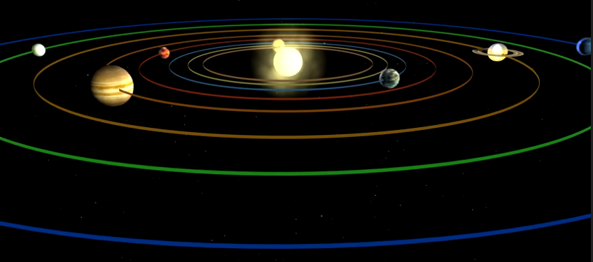

Slide 8
Concepts in Navajo Culture
Dine’ vs Diyin Nohookaa Dine’
Ya’at’eeh
Hozho
Sa’ah naaghai bik’eh hozho
Ke’
Defines our relationship and responsibilities to everything in the Universe (duties, obligations, responsibilities & expectations)

Slide 9
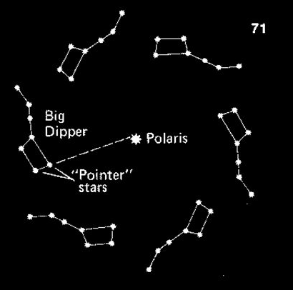

Slide 10
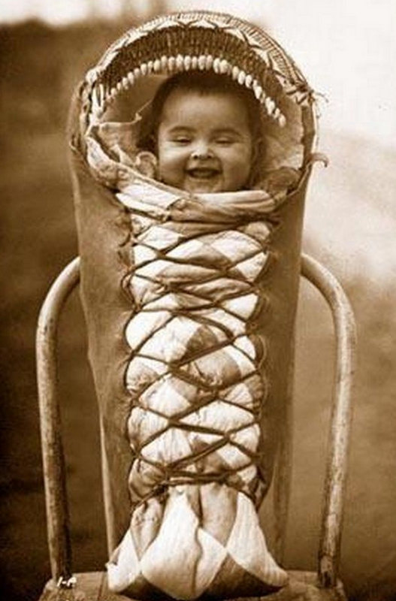
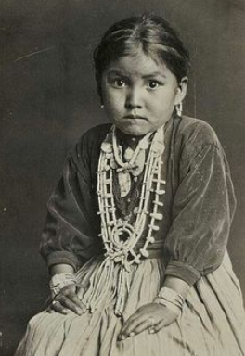
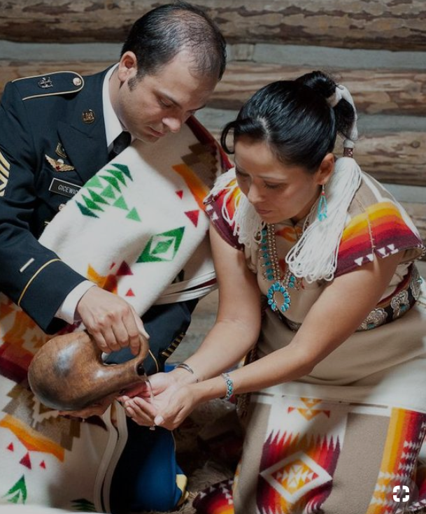
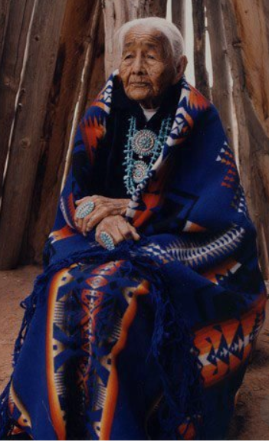
Sa’ah naaghai bik’eh hozho

